Slide 1
1^{st Quarter}
New Mexico Statewide Traffic Records
Coordinating Committee Meeting
October 9, 2019
Law Enforcement Academy

Slide 2
Agenda
Welcome/Announcements
Recognition Awards for E-citation Project – NMDOT Management
Review Meeting Notes from TRCC Meeting held July 17, 2019
2019 Traffic Records Forum Highlights – Sophia Roybal-Cruz
FFY17-19 TR Strategic Plan Closeout
FFY20-22 TR Strategic Plan Execution
Updates
Reporting/Monitoring
TraCS Overview and an Officer’s Perspective on how it has Improved Law Enforcement’s Process - By Sonia Abeyta & Lt. Ramon Terrazas
Closing

Slide 3
Welcome/AnNouncements
Sophia Roybal-Cruz – Promotion to Traffic Records Staff Manager & TRCC Chair
CONGRATULATIONS
Sophia!

Slide 4
Recognition Awards - E-citation Project
Project Team
Roberta Vasquez -NMDOT
Steve Harrington - AOC/JID
Sonia Abeyta – NMDPS
Officer Sean Healy – NMSP
Brian Bullard – Sensible IT Solutions
Chris Smead – Sensible IT Solutions
Brian Oborn – AOC/JID
Tobie Fouratt – AOC/Magistrate Courts
Christina Garcia – NMDPS (Former Employee)
Multi-Agency Effort
NMDOT/TSD
AOC/JID/Magistrate Courts
NMDPS
All 45 Magistrate Courts
All 600 State Police Officers
All DPS Districts and Subdistricts
Current Results (as of 10/3/19)
Total citations flowed: 43,928
Total errors: 2318
Success rate: 95 percent
Efficiencies
Officer’s time reduced from 10-15 minutes to 2-3 per citation (Officer time saved = 9152 hours
Citation processing reduced from 10-12 days (manually) to a few hours (electronically)
Go Team!

Slide 5
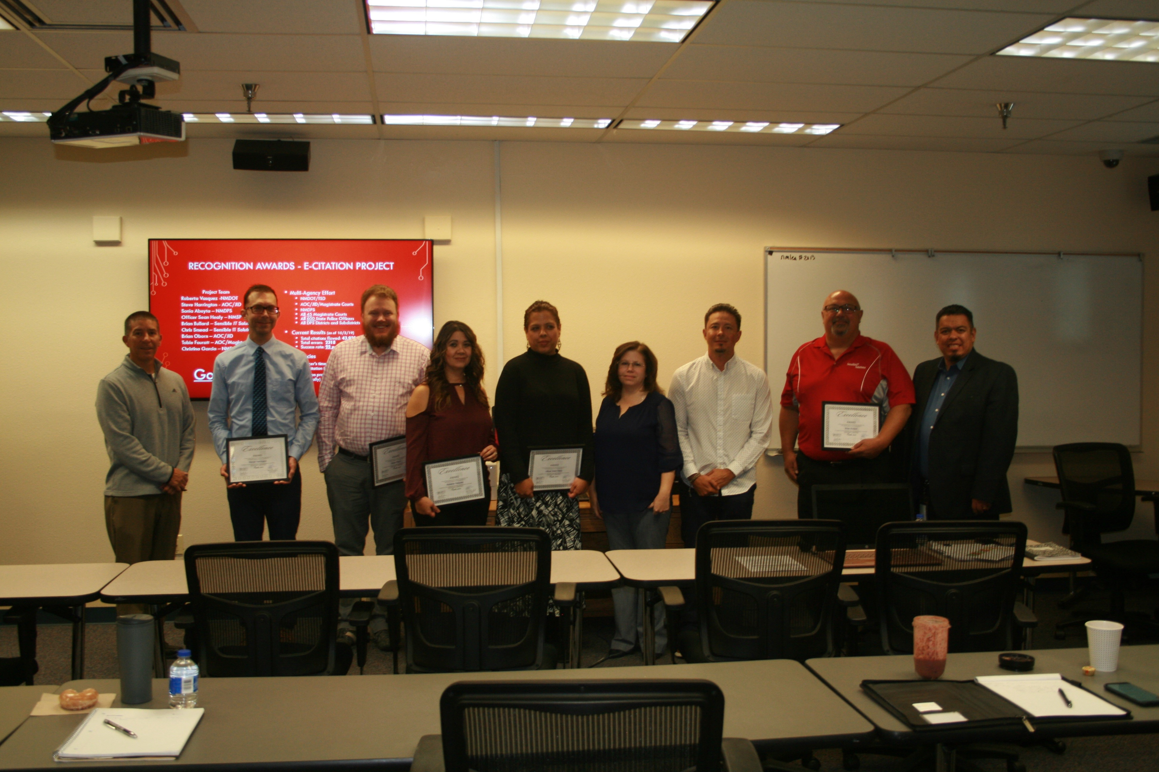

Slide 6
Review Meeting minutes from 4th QTR. TRCC 7/17/19
Welcome & Introductions
Approved 3rd Qtr. TRCC Meeting Minutes
Information for 2019 National Traffic Records Forum August 4th-7th, 2019 in Austin, TX.
Quarterly Meeting Dates for FFY20 Moved to 2nd Wednesday of QTR.
FFY17-19 Strategic Plan Update
FFY20-FFY22 TR Strategic Plan Execution
2021 TR Assessment Alignment
TRCC Agreement on Project Priorities
Roadway Data System Presentation
Closing and Meeting Adjourned
* Meeting minutes were approved by TRCC on 8/23/2019 and are posted @ http://nmtrafficrecords.com/wp-content/uploads/Final-4th-QTR.-2019-TRCC-PPT-Agenda-1.pdf

Slide 7
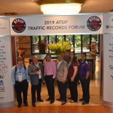
2019 Traffic Records Forum Highlights
2019 Traffic Records Forum
Aug 4-7, 2019 | Austin, Texas
By Sophia-Roybal Cruz

Slide 8
FFY17-19 TR Strategic Plan Closeout
Report on – How Did We Do?
Need all responses from TR Core System Stakeholders by 10/25/19
Final Closeout Report Due by 12/22/19

Slide 9
FFY20-22 TR Strategic Plan Execution
Updates
Need to Finalize Performance Measures (PM)
PM = quantitative indicators put in place to track the progress against strategy
Funding
Tie to Performance Measures
Current Status
Reporting/Monitoring

Slide 11
TraCS Overview and an Officer’s Perspective on how it has Improved Law Enforcement’s Process
By Sonia Abeyta & Lt. Ramon Terrazas

Slide 12
DPS TraCS
Sonia Abeyta/TraCS Program Manager
Lt. Ramon Terrazas/New Mexico State Police

Slide 13
TraCS and NMDPS:
In 2015, New Mexico Department of Public Safety (NMDPS) partnered with New Mexico Department of Transportation (NMDOT) to provide the TraCS application to New Mexico State Police Officers.
The project was successful and over 600 NMSP officers began using TraCS.
Since then, NMDPS has offered the TraCS application to all Law Enforcement Agencies (LEAs) throughout NM free of charge. We currently have 54 LEA’s using the TraCS application.

Slide 14
Accomplishments:
TraCS is providing 60% of the state of New Mexico’s electronic crash reports to NMDOT.
As of December 2018, 75,598 TraCS crash reports have been added to the state database.
For the first time, there are more crash reports submitted through TraCS than any other method.
This number will continue to grow as more agencies are added to the DPS TraCS Model.
Goal is to get 70% of all crash reports submitted electronically by 2020.

Slide 15
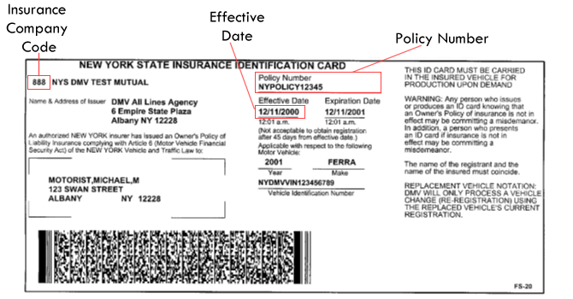
Collaboration with State Agencies:
TraCS has partnered with the Administrative Office of the Courts (AOC) to provide an interface for electronic citations (e-citations) to be exported from TraCS and electronically submitted to the Magistrate Court Odyssey Case Management System. Currently all NMSP district offices are using e-citation.
TraCS partnered with MVD to recognize 2D registration barcode information and populate the TraCS forms with that information.
TraCS has partnered with the Commercial Vehicle Enforcement (CVE) to provide a new Driver/Vehicle Examination Report (DVER) form for NMSP Commercial Vehicle Enforcement officers to submit inspection forms electronically to the Federal Motor Carrier Safety Administration (FMCSA) database.

Slide 16
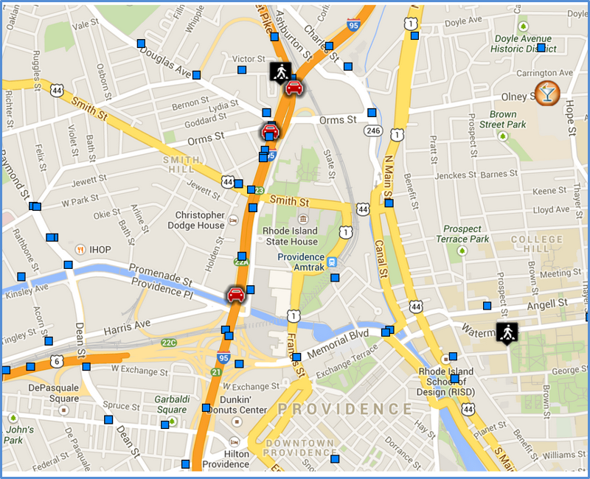
Future TraCS enhancements:
Provide enhancements to the LEADS import function to import NCIC data directly into TraCS.
Partnering with New Mexico Motor Vehicle Division (MVD) to build an interface allowing TraCS penalty assessment citations to be sent electronically to MVD.
Partnering with LexisNexis to utilize CrashLogic, an analytical, mapping and investigative tool which provides up to date information using a web portal.
Provide LEA’s a TraCS Records Management System (RMS) feature so agencies are able to store, query and retrieve their TraCS electronic data.

Slide 17
We have discussed TraCS as a program, but what does it really mean to the agencies that use it? How is it helping? What is the impact to the officer/command staff/admin staff/etc.?

Slide 18
Lt. Ramon Terrazas/NMSP

Slide 19
Questions?

Slide 20
Closing
Many Thanks to DPS for Hosting!

