Slide 1
NM Traffic Records Coordinating Committee
October 24, 2018
Drury Plaza Santa Fe

Slide 2
NM Traffic Records Coordinating Committee
AGENDA
Introductions
TR Overview – Vision/Mission & Organization
General Business
Strategic Plan FFY17 to FFY19
Strategic Planning for FFY20 (What’s Next?)
Closing & Next Steps

Slide 3
Introductions
30 Second Elevator Speech!
Name, agency/organization and position
Current responsibilities
Experience with Traffic Records Fun Fact

Slide 4
TR Overview
Franklin Garcia – Chair, STREOC
Jimmy Montoya – Chair, STRCC
TR Program Coordination Team –
Mike Archibeque (SME)
Sandra Martinez (Program Manager)
Tomas Aguirre (TR Integration Analyst)

Slide 5
Vision
The vision of the STRCC is to support the continuous reduction of traffic-related crashes, fatalities, and injuries in New Mexico. This is accomplished by facilitating cooperative human and agency resources, increasing technological capacities, and integrating existing data systems that can be used to perform analyses supporting the strategic and performance-based goals in the State Highway Strategic Plan (SHSP) and Highway Safety Improvement Program (HSIP).
Mission
Through a multi-agency coordination of effort, the STRCC’s mission is to develop and maintain a Statewide Traffic Records System (STRS) designed for electronic capture, processing, and dissemination of traffic-related records. This coordination is essential to providing efficient and secure delivery of accurate, timely, uniform and complete information about traffic activity to all who need such information.
There are six core information systems that make up the traffic records system: crash records, roadway inventory data, driver information, vehicle information, citation and adjudication records, and injury tracking information. The STRCC is committed to effectively implementing, continually improving, and integrating these six information systems to help achieve the goal of facilitating the timely sharing of accurate traffic records information across the State of New Mexico.

Slide 6
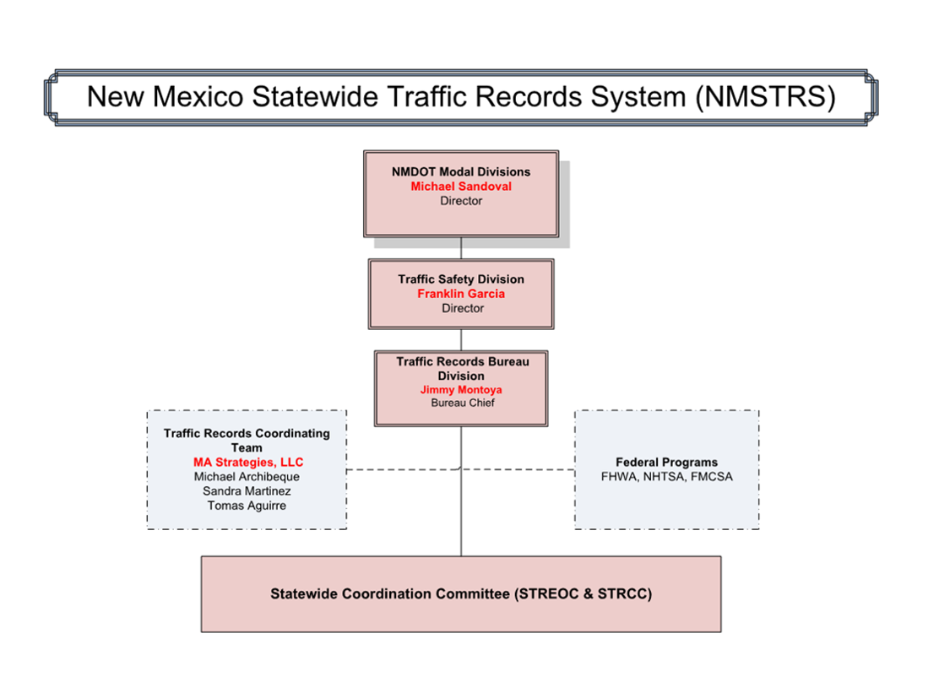

Slide 7
General Business
Charter Review
Survey Results
Set TRCC Meeting Schedule for FFY19 (Propose 3rd Wednesday of each Qtr.)
January 16, 2019
April 17, 2019
July 17, 2019
* Does not replace TR Workgroups

Slide 8
Let’s Make it Clear
AGENCY | CRASHES SENT THRU TRACS |  | PERCENT CHANGE
 | BASELINE | PERFORMANCE MEASURE
New Mexico State Police (NMSP) | 391 | 8,056 | +1960%
Rio Rancho PD | 125 | 1,578 | +1162%
Artesia PD | 37 | 464 | +1154%
Farmington PD | 109 | 1,201 | +1002%
Santa Fe PD | 1,917 | 3,505 | +83%
Bernalillo County SO | 0 | 1,458 | n/a
Los Alamos PD | 0 | 168 | n/a
Carlsbad PD | 0 | 151 | n/a
Sandoval County SO | 0 | 123 | n/a
San Juan County SO | 0 | 72 | n/a
Baseline Period: 01Apr2016 - 31Mar2017
Performance Measure Period: 01Apr2017 - 31Mar2018 Source: Crash database, as of 17Oct2018

Slide 9
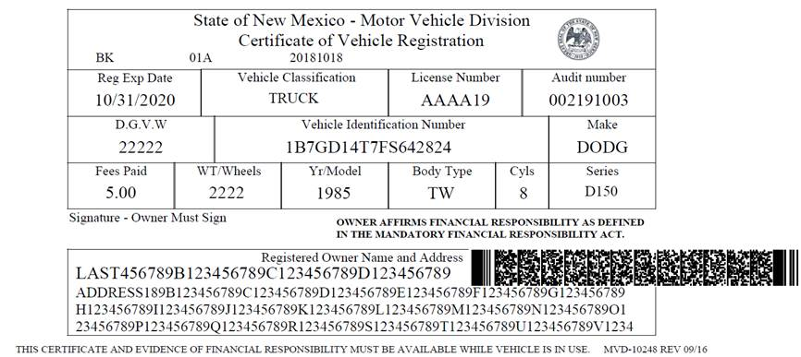
Out of Space (Not Outer Space)…

Slide 10
Strategic Plan FFY17- FF19
System Updates
Traffic Crash Records
Roadway Inventory Data
Driver Licensing Data
Vehicle Registration Data
EMS/Injury Surveillance
Citation Adjudication
NM STRCC
Other

Slide 11
Strategic Plan FFY17- FF19
TR Advisory – next few months for January
Priorities – SME Perspective – FFY20

Slide 12
Strategic Planning FFY20 (What’s Next?)
Fixing America’s Surface Transportation (FAST) Act Requirements (2015–2020)
1. Describe specific, quantifiable and measurable improvements.
2. Provide a list of all assessment recommendations.
3. Identify which recommendations the State will address.
4. Explain which recommendations won’t be addressed.

Slide 13
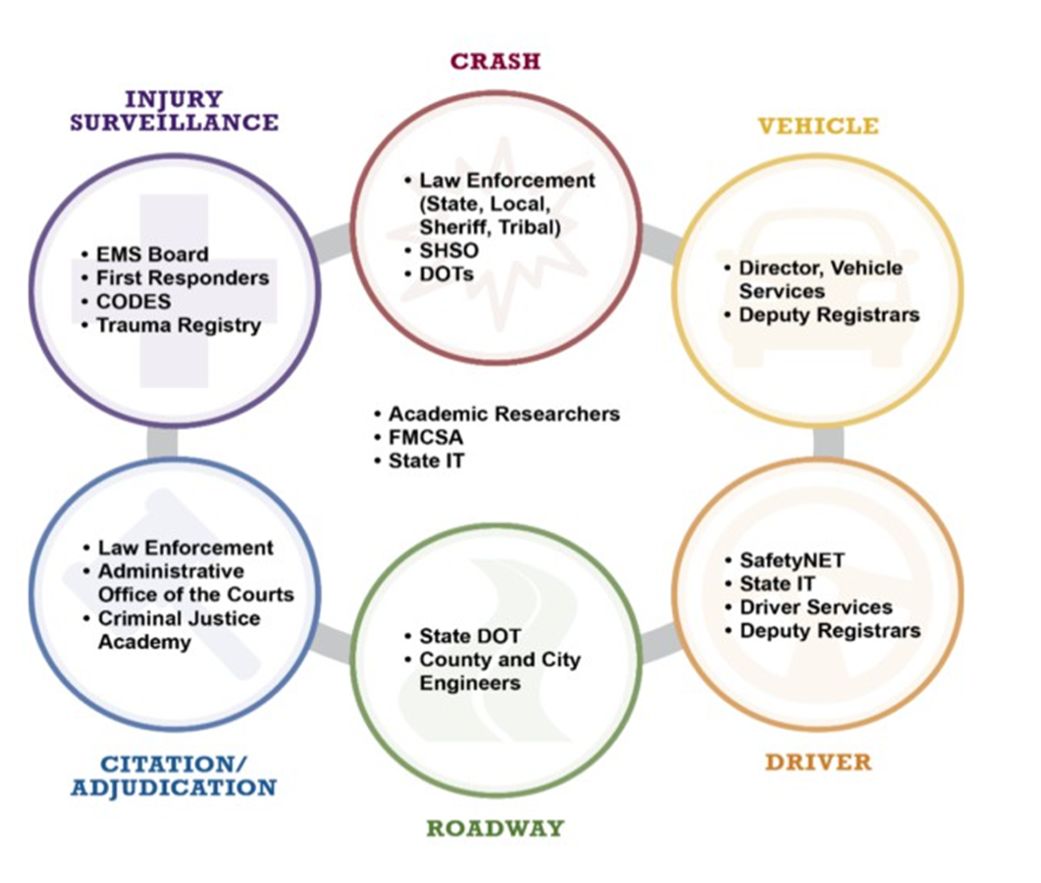
TRCC Stakeholders
Diverse group of parties interested in traffic records
Represent agencies receiving funding from SHSO
May not necessarily be TRCC members

Slide 14
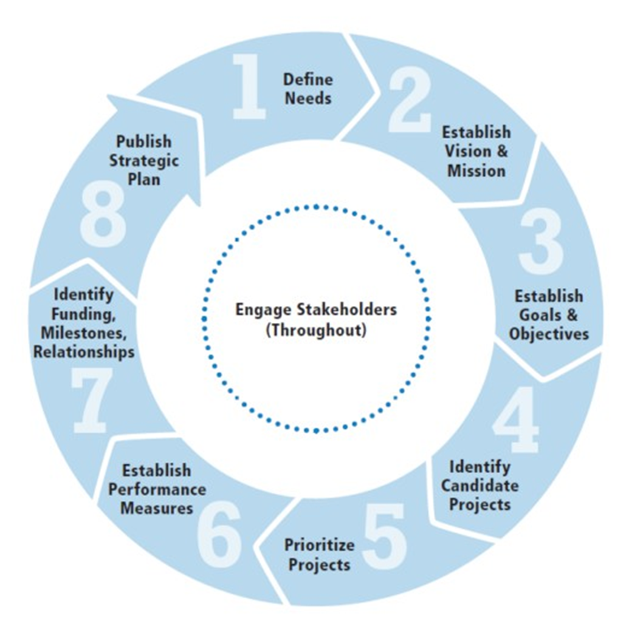
Strategic Planning Process

Slide 15
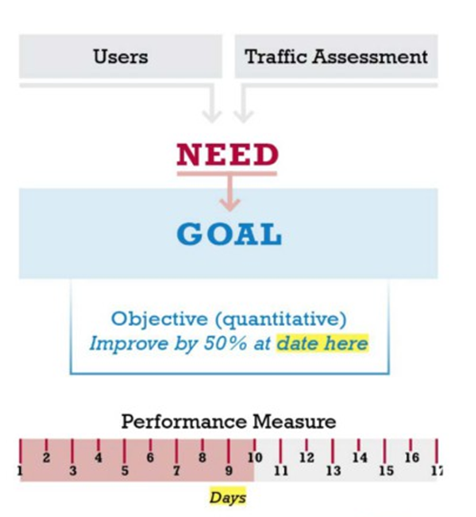
Key Terms
• Need: A challenge that the State considers in the TR Strategic Plan
• Goal: A high level statement of what the organization hopes to achieve.
• Objective: A quantified improvement to achieve by a specific date.
• Metric: A quantifiable performance target.
• Performance Measure: A mechanism for tracking progress toward meeting the metric.
8

Slide 16
Closing & Next Steps
Next Steps:
1. Identify and Finalize TR Workgroups
2. New Member Orientation
3. Identify and Formalize Performance Measures
4. Formalize a TR Activity Report
5. Formalize Data Standard
6. Discussion on STRS Technology Funding (Implementation and Sustainability)
7. Goal – Comprehensive Centralized TR Repository (Diagram for STRS)

Slide 18
Contact Information
Santiago (Jimmy) Montoya | TRCC Chair | NMDOT | 505-660-0511 | Santiago.Montoya@state.nm.us
Michael Archibeque | Subject Matter Expert | MA Strategies | 505-660-4155 | marchibeque@mastrategies.com
Sandra Martinez | Project Manager | MA Strategies | 505-231-6932 | smartinez@mastrategies.com
Tomas Aguirre | TR Integration Analyst | Ma Strategies | 505-470-0397 | tomas@tomasaguirre.com

